Slide 1
Implement Intelligent Enterprise Scenarios with SAP Cloud ALM
IIS266
Jagmohan S Chawla, SAP SE
Wulff-Heinrich Knapp, SAP SE

Slide 2
Disclaimer
The information in this presentation is confidential and proprietary to SAP and may not be disclosed without the permission of SAP. Except for your obligation to protect confidential information, this presentation is not subject to your license agreement or any other service or subscription agreement with SAP. SAP has no obligation to pursue any course of business outlined in this presentation or any related document, or to develop or release any functionality mentioned therein.
This presentation, or any related document and SAP's strategy and possible future developments, products and or platforms directions and functionality are all subject to change and may be changed by SAP at any time for any reason without notice. The information in this presentation is not a commitment, promise or legal obligation to deliver any material, code or functionality. This presentation is provided without a warranty of any kind, either express or implied, including but not limited to, the implied warranties of merchantability, fitness for a particular purpose, or non-infringement. This presentation is for informational purposes and may not be incorporated into a contract. SAP assumes no responsibility for errors or omissions in this presentation, except if such damages were caused by SAP’s intentional or gross negligence.
All forward-looking statements are subject to various risks and uncertainties that could cause actual results to differ materially from expectations. Readers are cautioned not to place undue reliance on these forward-looking statements, which speak only as of their dates, and they should not be relied upon in making purchasing decisions.

Slide 3
Agenda
Overview about SAP Cloud ALM
Overview on Session
Login Details
Rules of the game

Slide 4
About SAP Cloud ALM

Slide 5


SAP Cloud ALM – A brand-new, cloud-based application lifecycle management offering
SAP Cloud ALM
is cloud-native and open
For the intelligent enterprise
for cloud-centric customers
manages cloud and hybrid solutions
supports all components of the Intelligent Enterprise
In the public cloud
Rethought, newly designed, and built on modern cloud technology
Ready for immediate consumption
Cost-efficient for customers

Slide 6


SAP Cloud ALM – A brand-new, cloud-based application lifecycle management offering
Functionalities
Integrates with…
Application monitoring
Integration and user monitoring
Business process monitoring
Business process improvement
Monitoring
IT service management
Operation
People enablement
API hub
Collaboration
Implementation
Task management
Process management
Task management
Test management
Deploy management
Deployment tools
Test automation
Document management
SAP Cloud Platform
Platform services and data management

Slide 7
About the Exercise

Slide 8
Objectives
Chapter 1 – Create Project
Chapter 2 – Create Scope
Chapter 3 – Create Requirement
Chapter 4 – Create Manual Task
Chapter 5 – Mass upload and download
Chapter 6 – Task assignment
Chapter 7 – Mass Edit
Chapter 8 – Parallel projects

Slide 9
Login Details

Slide 10
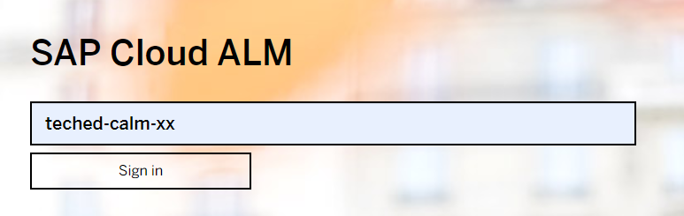
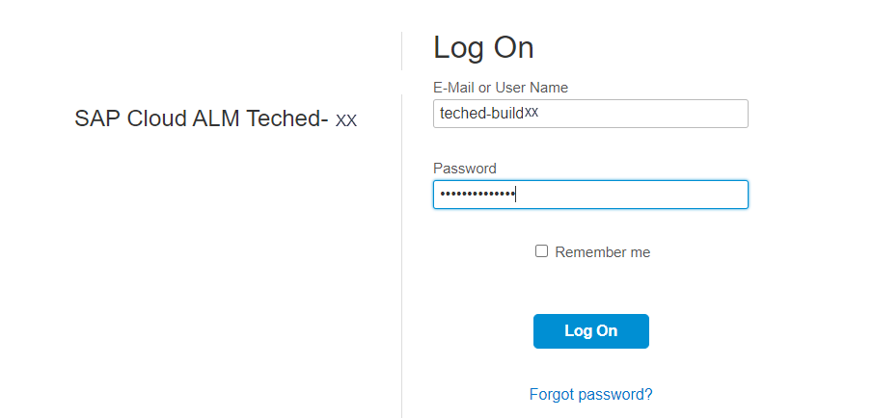
How to Login
URL :https://alm.cloud.sap/
Tenant Name: teched-calm-xx
User Name: teched-buildxx
Password: Teched-buildxx
Where xx is your group number

Slide 11
Rules of the game

Slide 12
Rules of the game
Have patience ☺
Raise your hand
One of the moderator will chat with you
If required a breakout session may be opened
Multiple people may be added to one breakout
Closing the breakout session will take you to the main session
Access the hands on Guide at https://github.com/SAP-samples/teched2020-IIS266

Slide 13
Thanks to --
Krakowski Jr, John
Seidler, Sinje
Sonal Kumar
Dietzel, Erik
Nico Hoffman
Moderartors
Event Team

Slide 14
Jagmohan S Chawla
Wulff-Heinrich Knapp

